Slide 1
Advanced Digital Design Motion Estimator
By The Charismatic Chuan Li, The Dignified Dahlen Lakin, and The Ostentatious Oscar Barajas

Slide 2
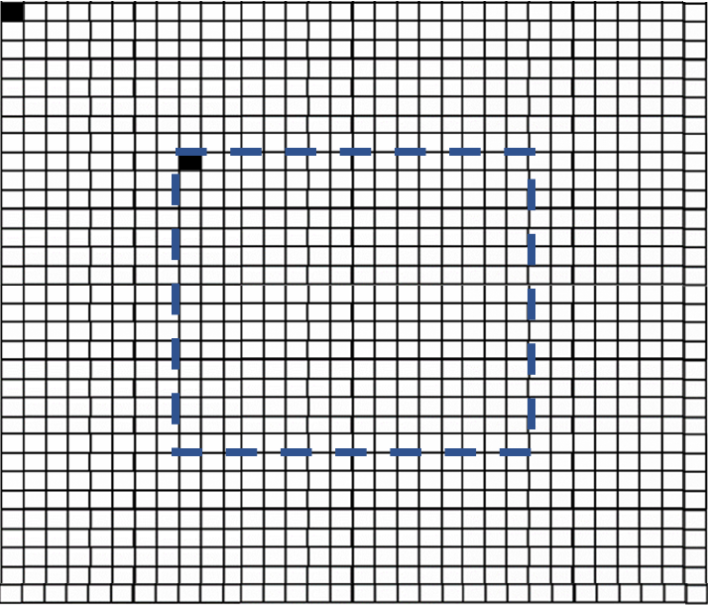
Design Specifications
16x16 Reference Block
31x31 Search Window
Grey-scale coded pixels
Clocks available : 260 MHz
32x28 nm CMOS library

Slide 3
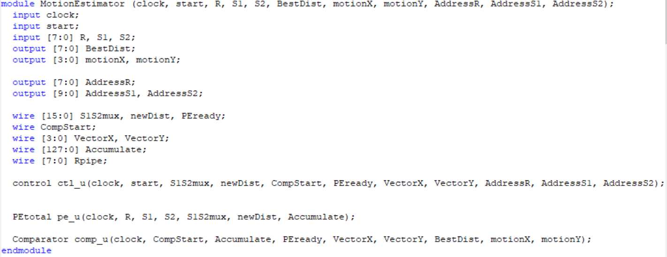
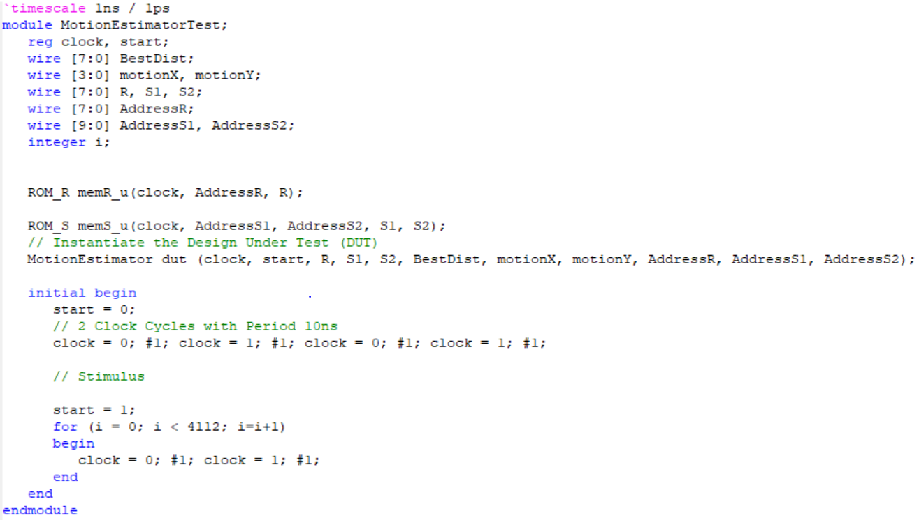
Top Module

Slide 4
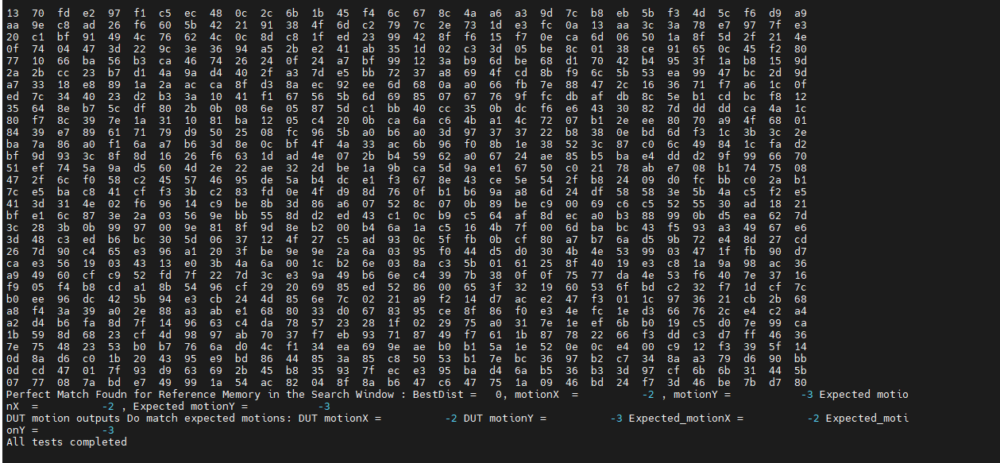
VCS Verification & Simulation
There are three main steps in debugging the design, which are as follows
1. Compiling the Verilog/VHDL source code.
2. Running the Simulation.
3. Viewing and debugging the generated waveforms.
Notes:
In this step, the design and testbench are compiled using Synopsys VCS. During compilation, VCS checks the design for syntax errors, module connectivity, and signal mismatches. If the design does not compile successfully, the simulation cannot proceed, so this step ensures that the RTL is structurally correct and ready to execute.

Slide 5
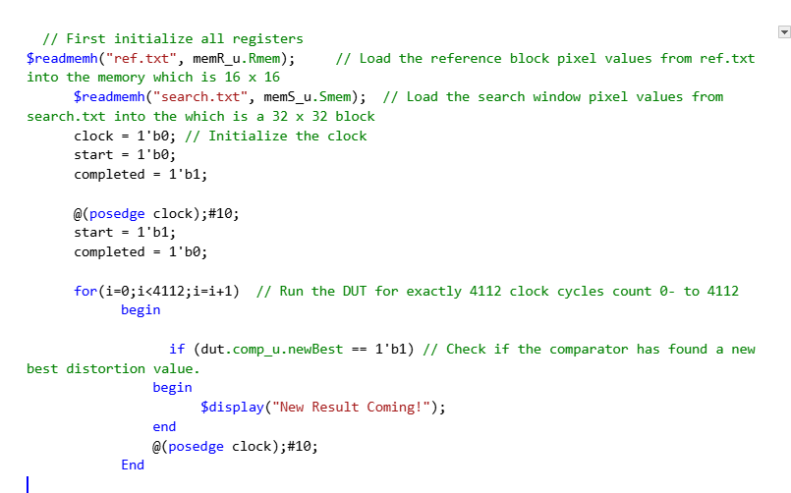
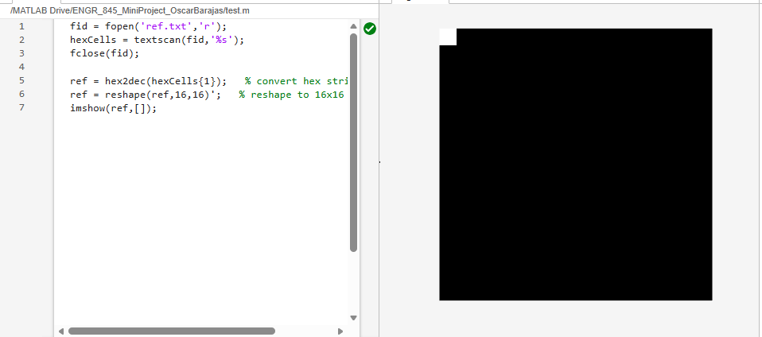
What is the input being Tested?
Notes:
The testbench begins by loading two input files using the $readmemh command.
The first file, ref.txt, is loaded into the reference memory and represents a 16 by 16 reference image block. This block contains the pixel pattern that the design is trying to locate.
The second file, search.txt, is loaded into the search memory and represents a 32 by 32 search window. This larger window defines the region where the reference block is searched for possible matches.

Slide 6
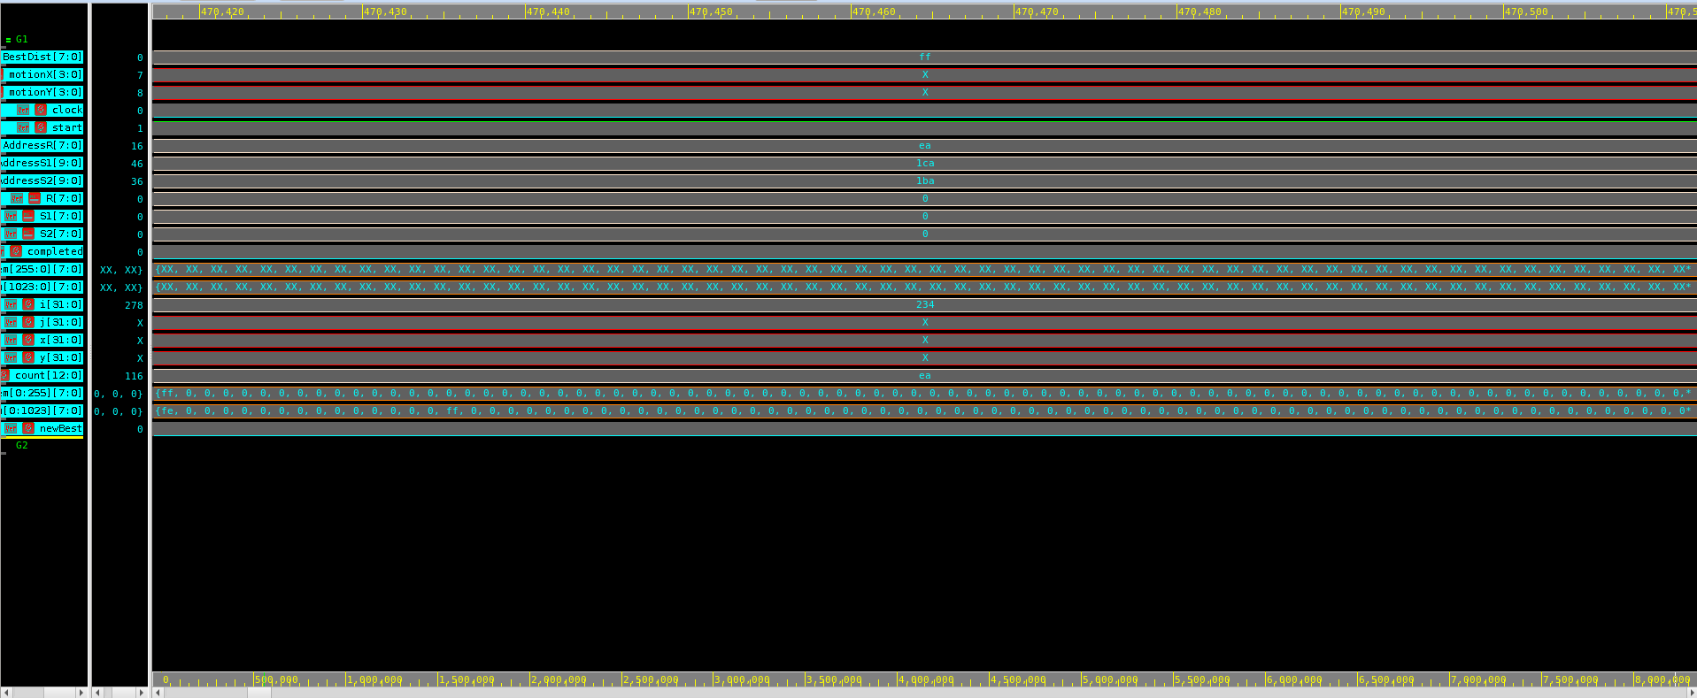
Motion Estimator Functional Verification – Waveform Worst-Case
Notes:
This image shows the waveform during the first few clock cycles of the motion estimation process.
At this early stage, we can see that the BestDist signal is equal to 8'hFF, or 255, which corresponds to the out put message “Not Found the frame in the Search Window.”
This waveform represents the worst-case scenario during functional verification of the motion estimator.

Slide 7
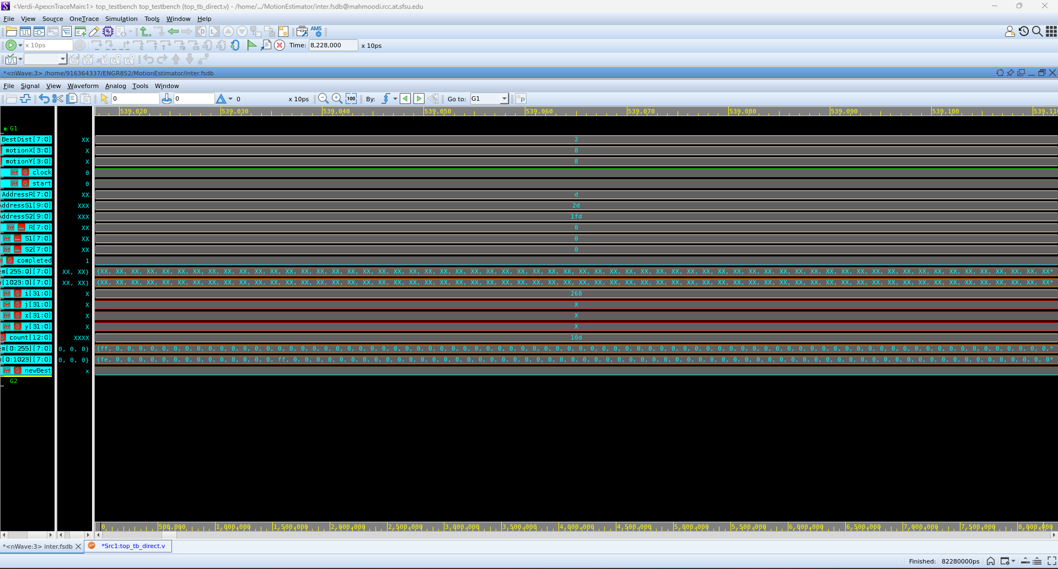
Motion Estimator Functional Verification – Waveform Better-Case
Notes:
In this better-case waveform, BestDist equals 2 which is non zero number but not zero , indicating a partial match that is close to the reference image, which correctly triggers the “Almost Found the frame in the Search Window” message.

Slide 8
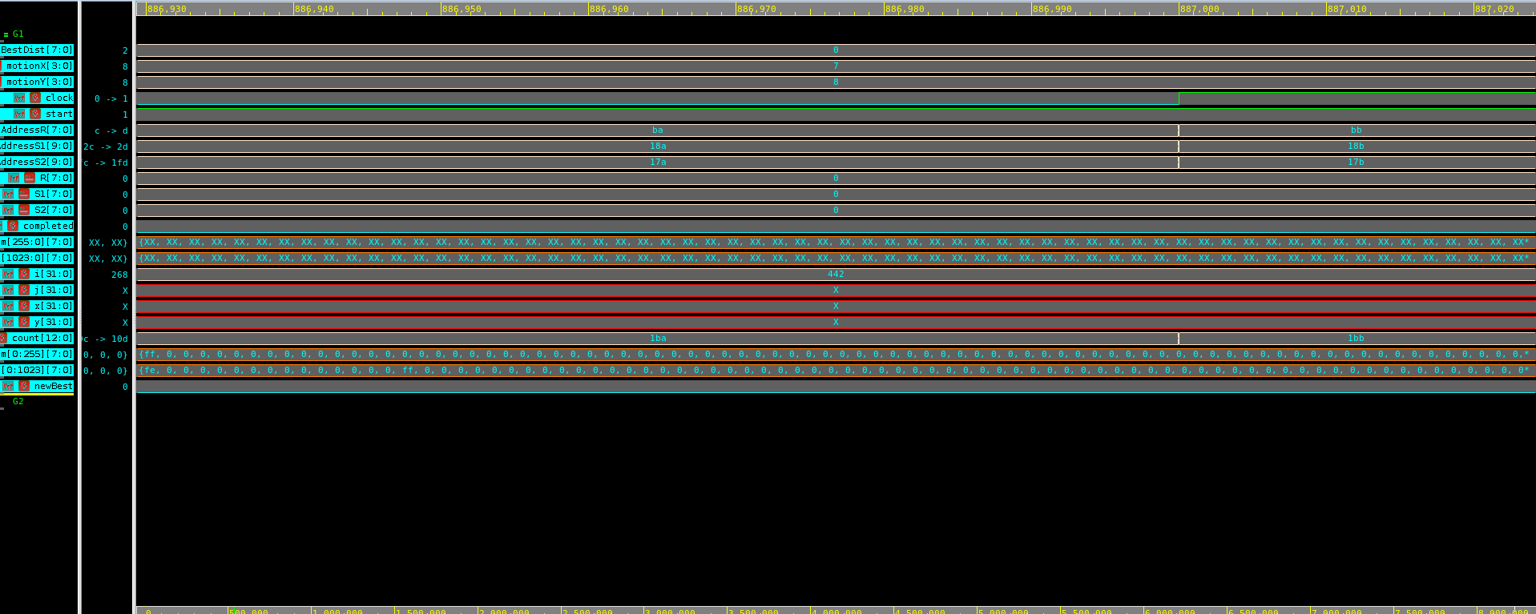
Motion Estimator Functional Verification – Waveform Best-Case
Notes:
This waveform represents the best-case scenario in the functional verification of the motion estimator. In this case, the BestDist signal equals zero, meaning the value of BestDist is exactly 0 A BestDist value of zero indicates a perfect match between the 16×16 reference block and a selected 16×16 block within the search window.

Slide 9
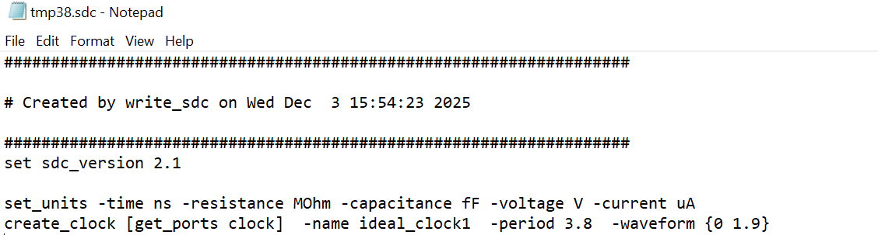
Synthesis Constraints
Notes:
For synthesis, we use Synopsys Design Compiler within the dc_shell-xg-t environment, which provides access to the technology libraries containing all standard cells and gates.
We then import our RTL using analyze and elaborate to build the structural representation of the design.
After applying a clock constraint with create_clock, we evaluate the timing slack.
Through this analysis, we determined that a 3.8-nanosecond clock period was appropriate for our design.

Slide 10
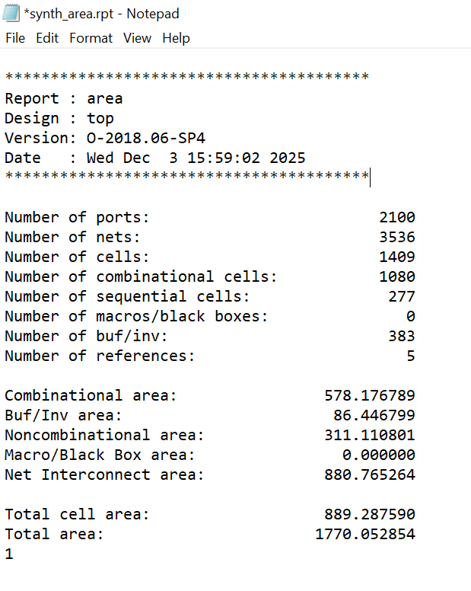
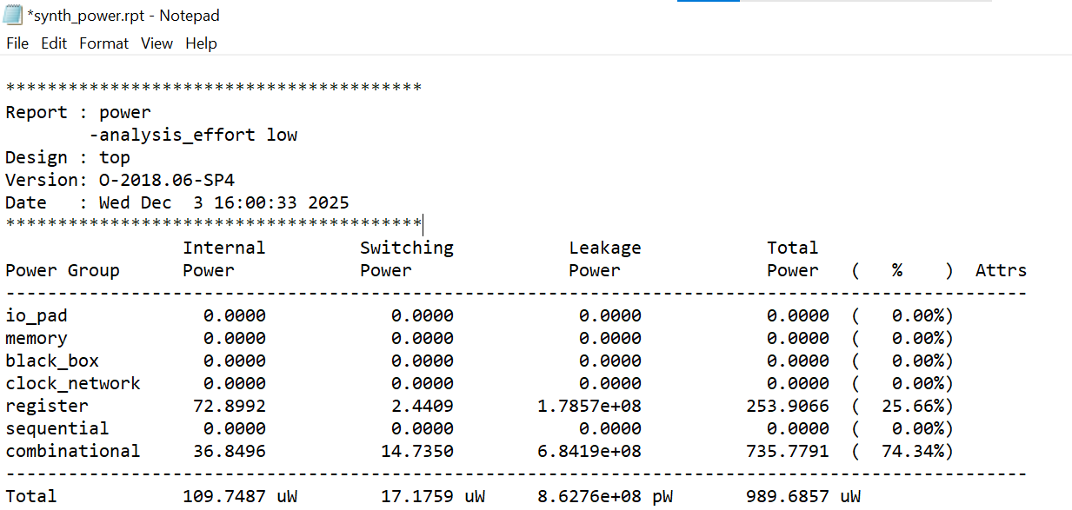
Synthesis Power and Area
Area Report
Power Report
Notes:
The synthesis timing report shows positive setup and hold slack, indicating the design meets timing with no violations at this stage.

Slide 11
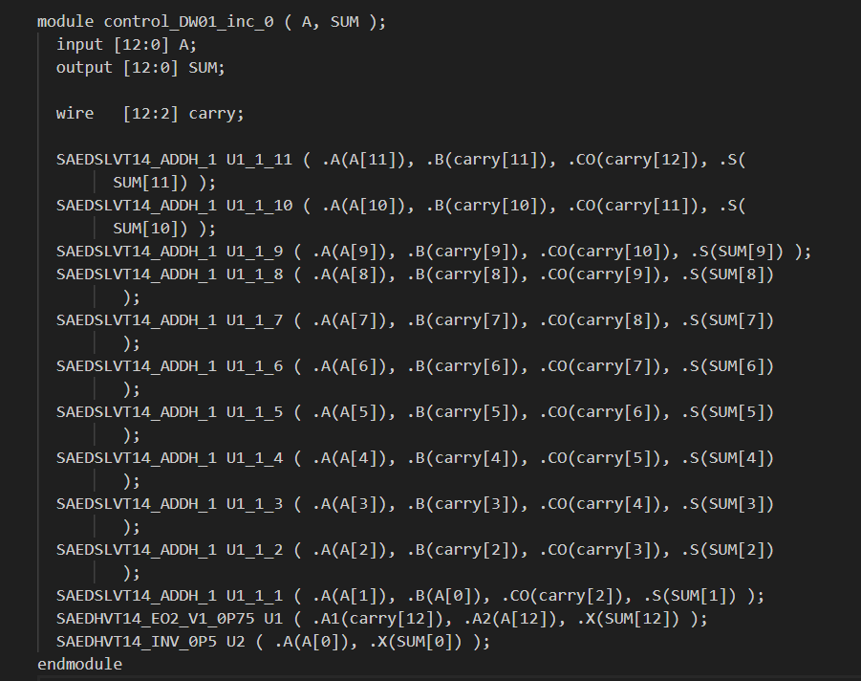
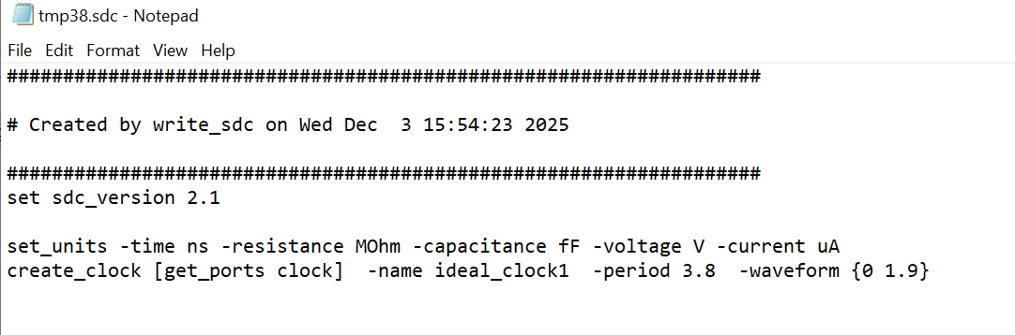
Synthesis Netlist and Timing Constraints
Netlist
Timing Constraints
Notes:
Because our synthesis timing was clean, Design Compiler generated the corresponding SDC file, including the finalized 3.8-ns clock constraint.
The ddc file is the saved design database—the “golden” representation of the synthesized circuit—while the sdc captures the timing constraints.
From this validated database, we produce the synthesized netlist.
After compile optimization, this netlist becomes the foundation for the physical design stage.

Slide 12
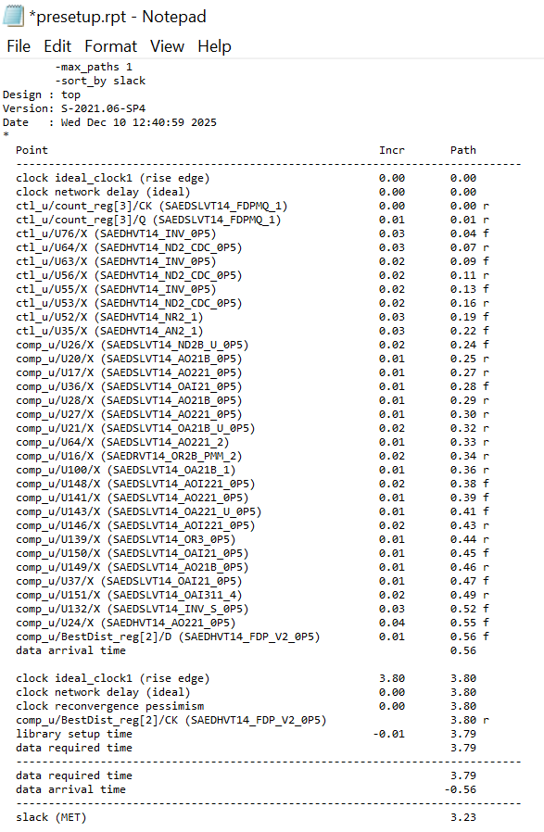
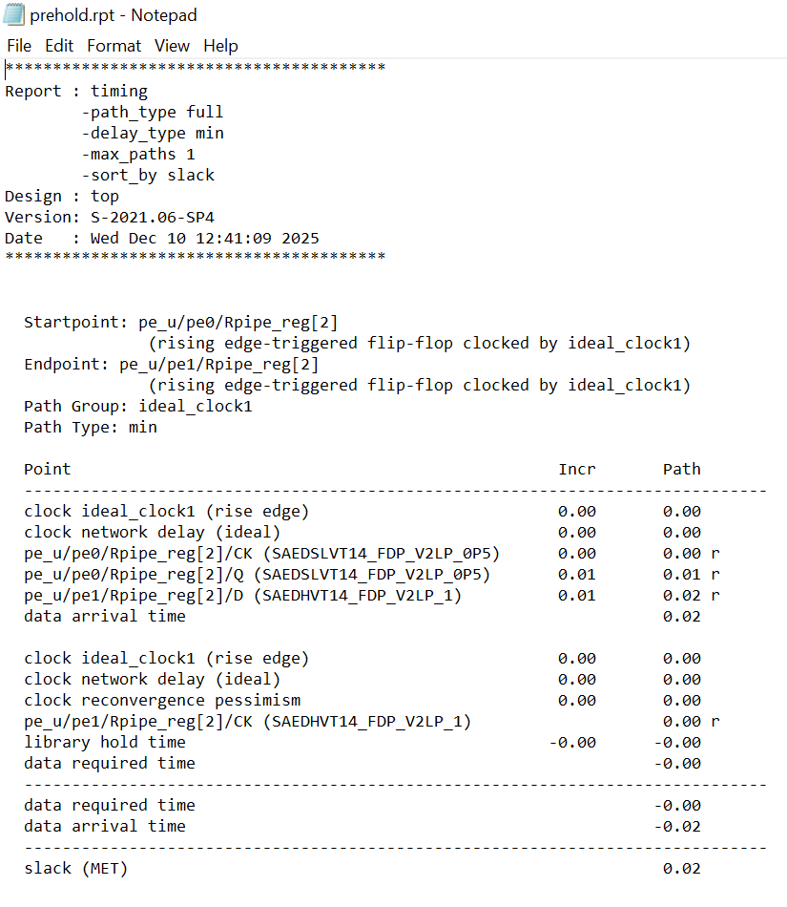
Post-Synthesis Static Timing Analysis
Set-Up
Hold
Notes:
This slide shows our post-synthesis static timing analysis (STA).
Before entering physical design, we run PrimeTime to evaluate the timing quality of the netlist.
We check both setup and hold times to identify early timing violations.
The reports here summarizes the worst path’s slack values, giving us a baseline before placement and routing.
Starting the Flow: Pre-layout STA
Before entering the physical design stage, the first thing we do is run static timing analysis, or STA.
We use PrimeTime, which is a timing verification tool that evaluates whether our design meets setup and hold requirements based on the synthesized netlist and constraints.
At this stage, the design has no physical information yet—no placement, no routing, no parasitics.
So this pre-layout STA gives us an initial understanding of the timing quality of our netlist.
We generate two main timing reports:
A setup timing report, which checks whether signals can arrive in time.
A hold timing report, which ensures signals do not arrive too early.
These reports help us confirm that the design is ready to move into physical implementation

Slide 13
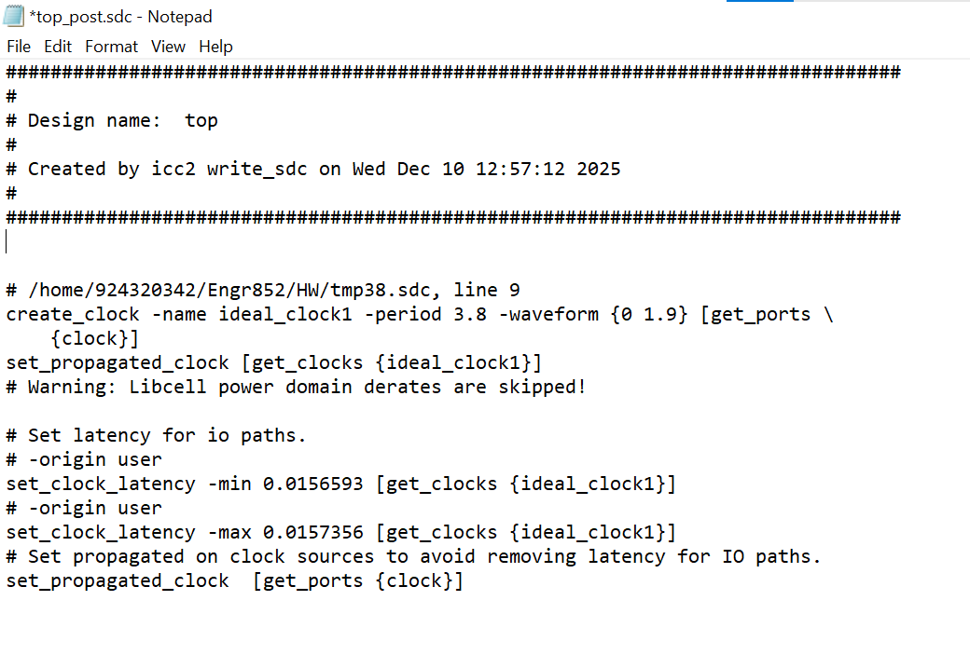
Physical Design Constraints
Notes:
Physical design follows several key stages: floorplanning, placement, clock tree synthesis, and routing.
The SDC shown here provides the timing constraints used throughout these steps.
It links back to the 3.8-nanosecond clock period defined in our earlier timing design, ensuring that the entire physical implementation is built on consistent timing assumptions.
Physical Design Stage
Once we finish pre-layout STA, we begin the actual physical design, using ICC2.
This stage is where the netlist is transformed into a real physical chip layout.
We can divide the physical design process into several major steps:
(1) Floorplanning
We define the overall structure of the chip—its area, core boundary, and the locations of IO ports and power structures.
(2) Placement
Next, all the standard cells are placed onto the chip.
After placement, we run timing checks again, which give us updated setup and hold reports based on cell positions.
(3) Clock Tree Synthesis (CTS)
We then build the clock tree to ensure the clock signal arrives uniformly across the design.
After CTS, we evaluate the clock quality and check timing again.
(4) Routing
Finally, we route all the wires that connect the cells.
This includes global routing, detailed routing, and routing optimization.
After routing, we generate a complete set of reports—area, power, QoR, utilization, and updated timing reports.
By the end of this stage, the design is fully placed and routed, but not yet analyzed with real parasitics.

Slide 14
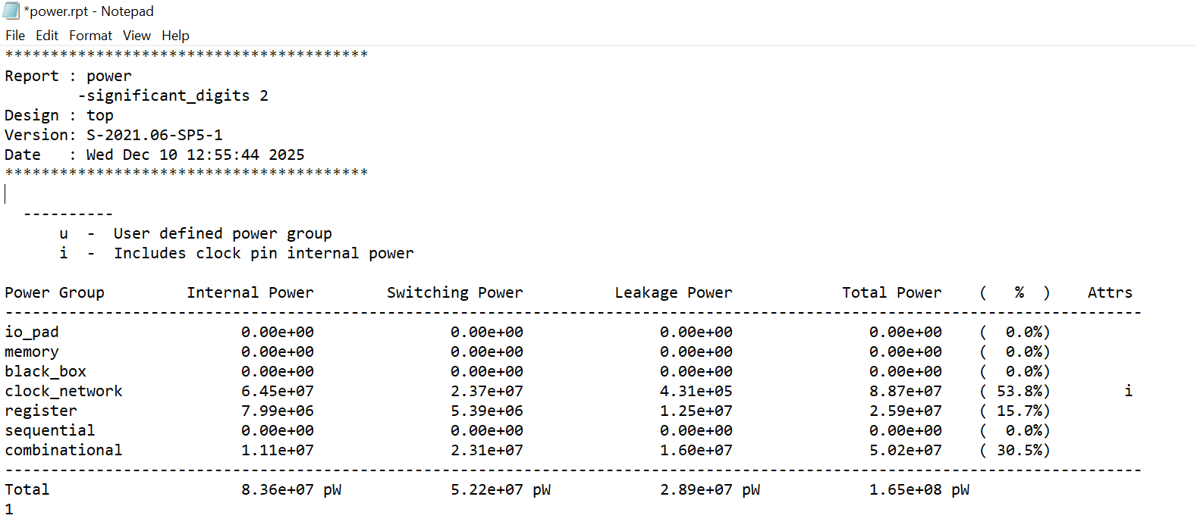
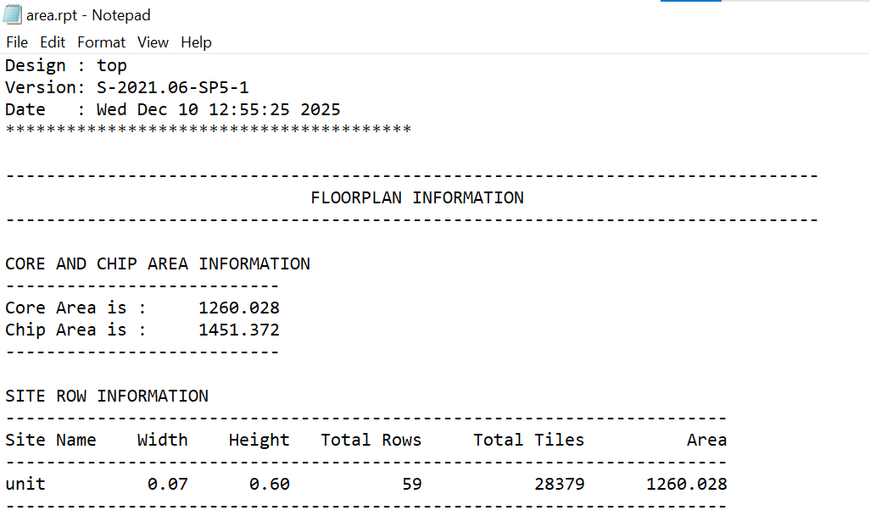
Physical Design Power and Area
Power Report
Area Report
Notes:
Here we show the physical design power and area reports.
Compared with the synthesis results, the metrics changed because placement, routing, and real parasitics were introduced.
These reports provide a more accurate view of the chip’s final power consumption and physical area.

Slide 15
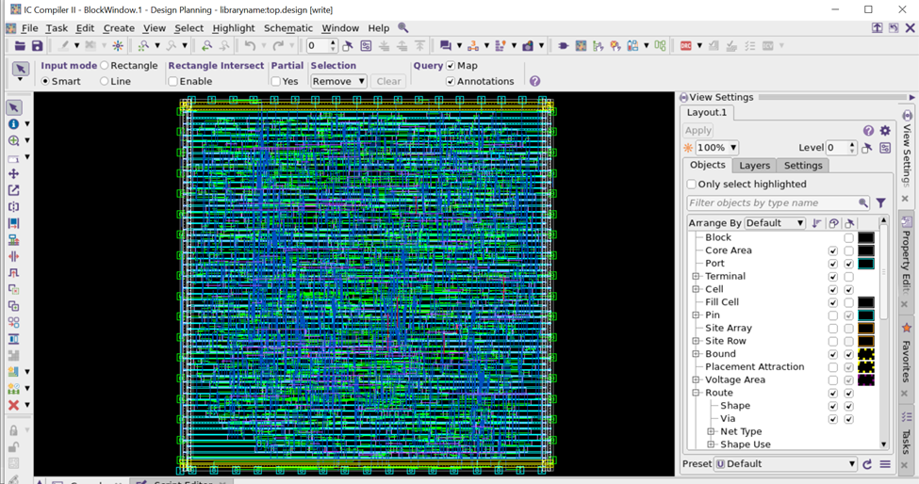
Physical Design Board
Notes:
This view shows the ICC2 layout board, displaying the placed cells and routed interconnects that form the final physical chip structure.

Slide 16
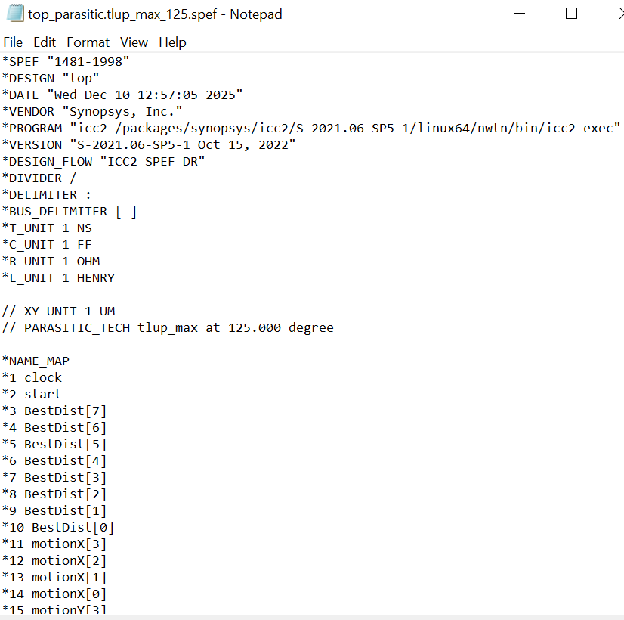
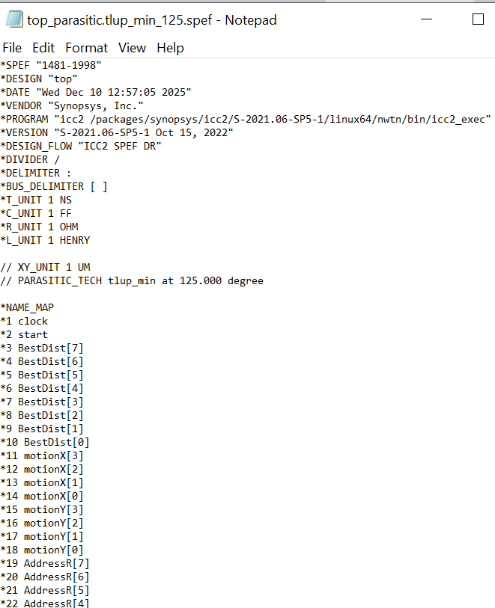
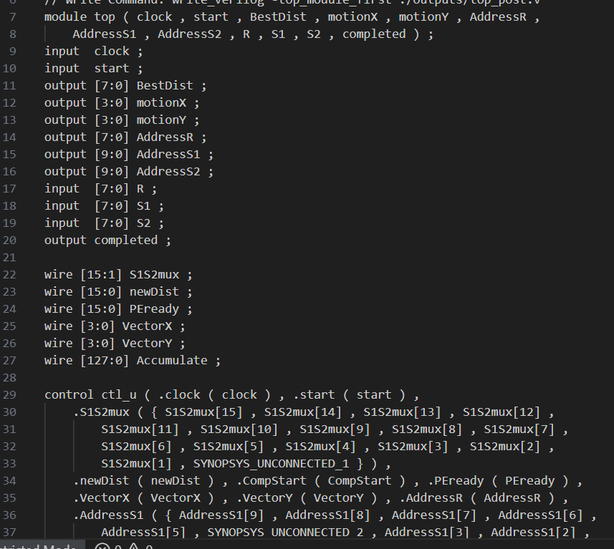
Physical Design Output
RC Parasitics
Netlist(top_post.v)
Notes:
Here we show the physical design outputs.
After routing, we extract detailed RC parasitics for both max and min corners, capturing real wire resistance and capacitance.
After extracting these parasitics, ICC2 generates a post-layout netlist and updated SDC.
This netlist reflects the actual routed design and is used for final timing analysis in PrimeTime.
3. Parasitic Extraction
Once routing is complete, we extract the actual parasitic effects from the layout.
These parasitics—such as real wire capacitance and resistance—have a direct impact on timing.
We generate an extracted version of the design, including:
A post-layout netlist
A post-layout SDC
A SPEF file containing parasitic information
This extracted data allows us to run a much more accurate timing analysis.

Slide 17
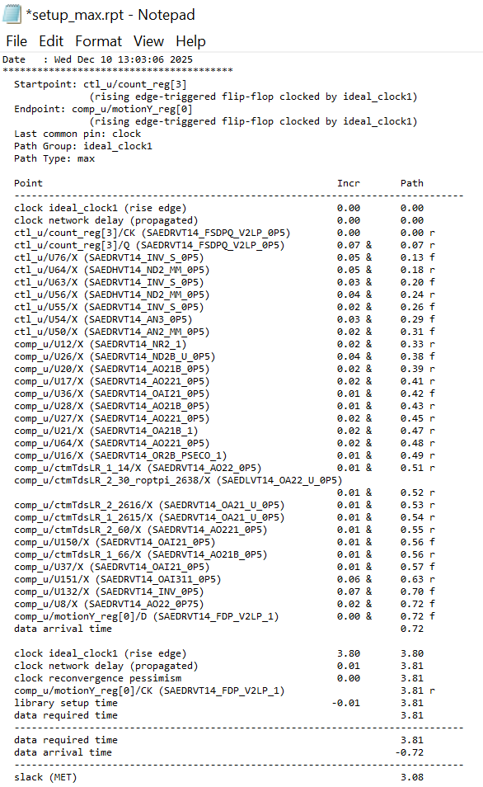
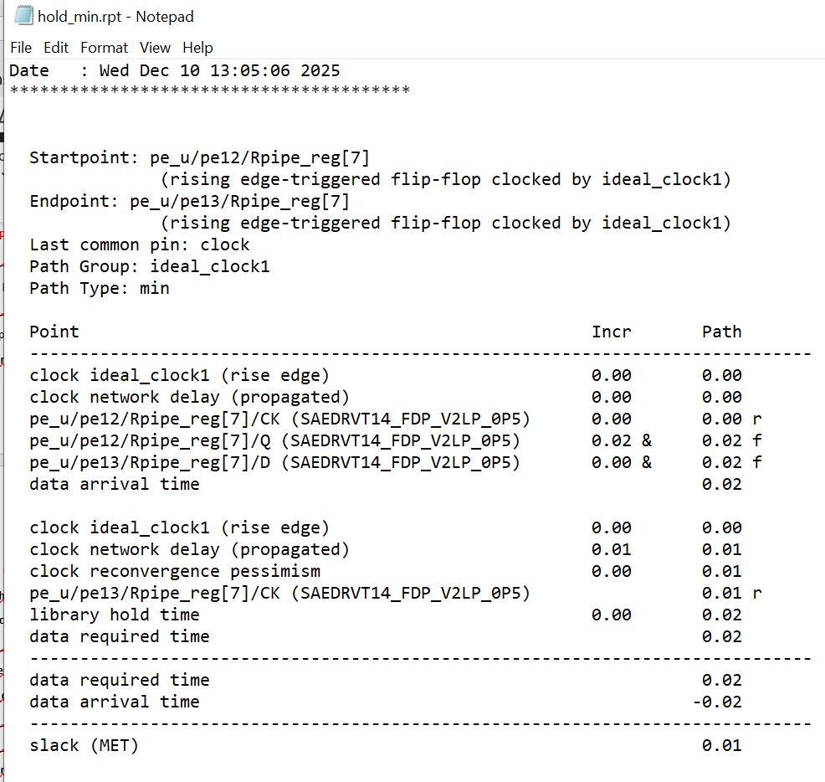
Post Layout Timing Analysis & Sign-Off
Timing Report
Notes:
Using the extracted parasitics from the SPEF files together with the post-layout netlist, we perform final setup and hold analysis in PrimeTime.
This post-layout STA reflects actual routed delays, including wire resistance and capacitance.
The reports shown here represent our sign-off results, confirming timing closure for both the MAX corner (setup) and the MIN corner (hold).
4. Post-layout STA
After combining the layout parasitics with the netlist and constraints, we perform post-layout timing signoff in PrimeTime.
Here we analyze two corners:
(1) The MAX delay corner
Used for checking setup timing, ensuring signals can travel fast enough across long wires with parasitic loading.
(2) The MIN delay corner
Used for hold timing, ensuring signals do not arrive too early due to short paths.
At the end of this stage, we produce two final signoff reports:
A post-layout setup timing report
A post-layout hold timing report
These reports represent the true timing behavior of the chip and determine whether the design is ready for tape-out.
Conclusion
To summarize:
We start with pre-layout STA to verify the netlist.
Then we go through the physical design process—floorplan, placement, CTS, and routing—evaluating timing along the way.
After routing, we extract real parasitics from the layout.
Finally, we run post-layout STA, which incorporates those parasitics and generates our final timing signoff.
This complete flow ensures that the design meets timing requirements under realistic conditions before it can move to manufacturing.

